Slide 1
Using Hip-Hop Pedagogy as a Literacy Building Tool
Courtne Thomas, Ed. D.

Slide 2
Learning Objectives
In this session, you will learn:
Strategies and techniques to incorporate hip-hop as words and music to build hunger for literacy
Leave session with concrete tools for using hip-hop literacy as a teaching strategy
To share data about how hip-hop literacy education works and why

Slide 3
K-W-L: What do you know, Want to know, and want to learn about the five art forms of hip-hop?
Beatboxing
Emceeing
Graffiti
Breakdancing
Deejaying

Slide 4
The Problem at the Classroom Level
My colleague and I would often discuss the lack of interest and disengagement our students demonstrated with my former district’s proffered curriculum
Simply put, children would observably check out as curriculum was not relevant to their experiences

Slide 5
What is Hip Hop Pedagogy?
Hip Hop Pedagogy acknowledges how hip-hop curriculum can be used as a form of liberatory practice potentially reducing some of the existing achievement gaps (Solorzano & Delgado Bernal, 2001)

Slide 6
The Message: What is it?
The curriculum unit was designed for students with varying academic abilities in grades 6-8.
The lessons build students’ understanding of hip-hop and its relationship to social justice issues and the entrepreneurial spirit:
The origin and history of hip-hop
Merging cultural ideas, talents, and circumstances that influence the music style
Understanding the fundamental source of hip-hop’s existence

Slide 7
The Message continued
The program offers a three-prong approach to learning: hip-hop pedagogy, entrepreneurial spirit, and social justice.
Central to hip-hop music is a storytelling narrative about the political, social, and economic challenges faced by people living in poor communities.

Slide 8
The Message: Published in May 2015 and program piloted in March 2016

Slide 9
Survey Results
100 Male and 100 Female Students Randomly Surveyed

Slide 11
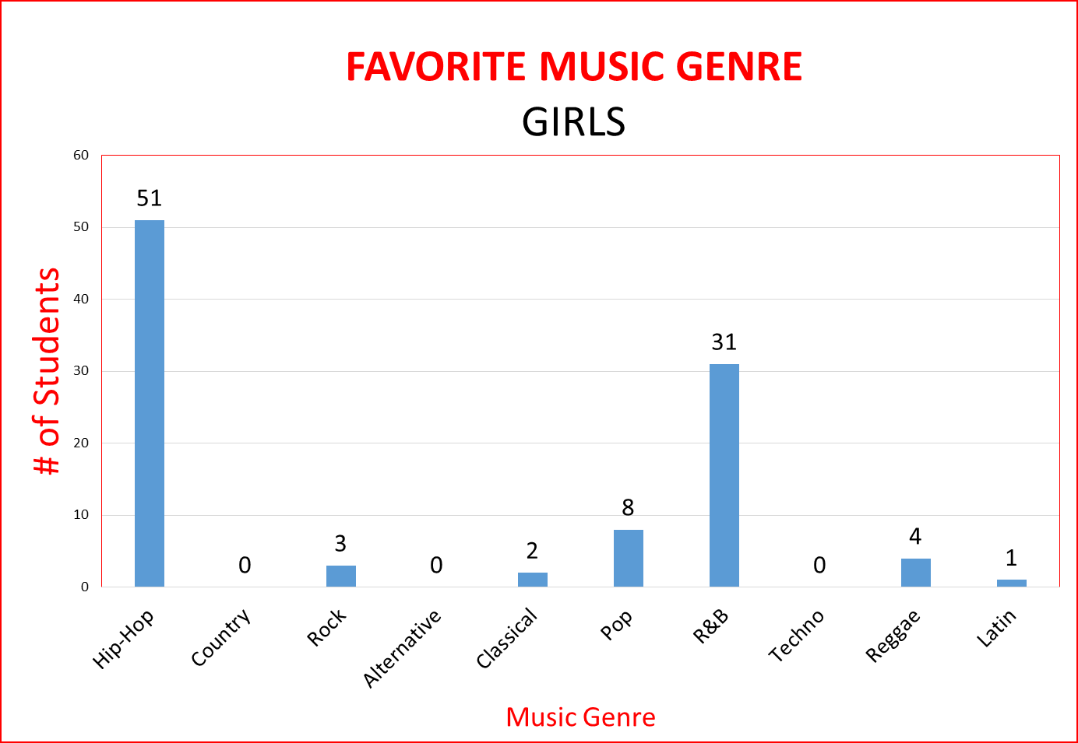

Slide 12
The Data: Side by Side
100 Male Students Randomly Surveyed
100 Female Students Randomly Surveyed

Slide 13
With my student demographic in mind...
The Theoretical Frameworks were: Critical Race Theory and Critical Hip-Hop Pedagogy

Slide 14
Theoretical Framework
Critical Race Theory (CRT)
Hip-Hop Pedagogy
Critical Race Theory (Ladson-Billings and Tate, 1995) emphasizes the role race plays in student achievement
Hip Hop Pedagogy acknowledges how hip-hop curriculum can be used as a form of liberatory practice potentially reducing some of the existing achievement gaps (Solorzano & Delgado Bernal, 2001)

Slide 15
Research Questions | Data Collection Instruments
1. How does a hip-hop education program affect the identified academic deficiencies of African-American and Latino students in middle school Language Arts? | Pre-assessment survey, Post-assessment survey, Pre-Test, Post-Test, Language Arts Benchmark Cycle Test scores from cycles one and two
2. How does a hip-hop education program affect student engagement of African-American and Latino students? | Observations, Pre-assessment survey, Post-assessment survey, Pre-Test, Post-Test, Language Arts Benchmark Cycle Test scores from cycles one and two

Slide 16
Student Group and Number of children
Sample group: Study group were my former students between the ages of 11 and 14
Small sample size: 24 male and 22 female students will not yield investigators with the unequivocal evidence of student learning across the sample group that might result with a larger sample

Slide 17
Findings
More than 80 percent of the program participants’ demonstrated growth as evidenced on benchmark assessments
Approximately 40 percent of the students met the initial program goal of 10 percent improvement on designated ELA New Jersey Student Learning Standards as evidenced on the district’s Model Curriculum Assessment
89 percent of the 42 participants responded that they learned more about the challenges faced by inner-city residents studying hip-hop

Slide 18
Close Reading and Discussion
What is the author’s message to his or her readers? (CCRA.R.8-College and Career Readiness Reading Anchor Standards)
Does the author support the intended message with adequate information? Cite textual evidence to support your opinion (CCRA. R.8)
Locate a sentence, phrase or paragraph that describes or explains something. Cite textual evidence to explain how. (CCRA.R.6)

Slide 19
What is the central idea of this song? Cite evidence to prove it. (CCRA.R.2) Turn and Talk: 2 minutes
College and Career Readiness Reading Anchor Standards (CCRA.R)

